Slide 1
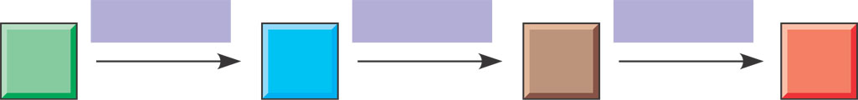
Organization of the Chemistry of Life into Metabolic Pathways
A metabolic pathway has many steps
  That begin with a specific molecule and end with a product
  That are each catalyzed by a specific enzyme
Enzyme 1
Enzyme 2
Enzyme 3
A
B
C
D
Reaction 1
Reaction 2
Reaction 3
Starting
molecule
Product

Slide 2
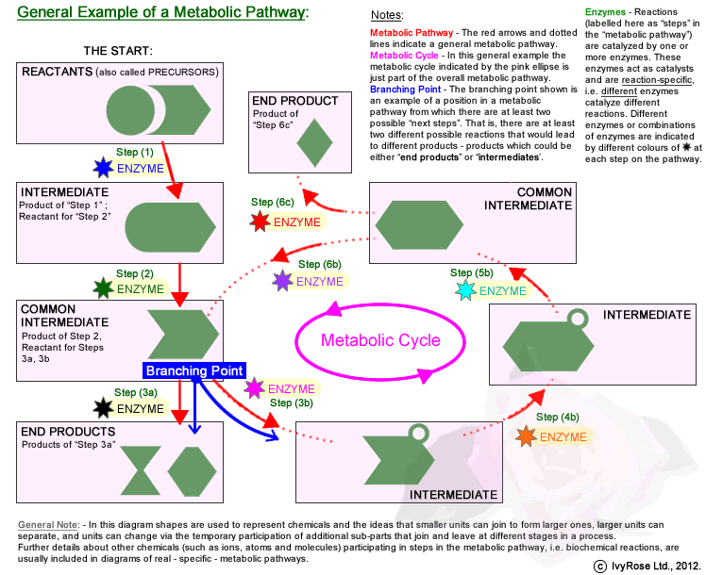

Slide 3
2 metabolic pathways in our bodies
Catabolic Pathways
Anabolic Pathways
Breaks down complex molecules into simpler compounds.
EX:
amylase breaks complex starches into simple sugars.
The process of cellular respiration.
Consume energy to build complicated molecules.
EX:
Anabolic steroids = to build muscle.
The building of a protein from amino acids.

Slide 4
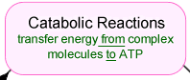
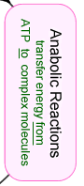
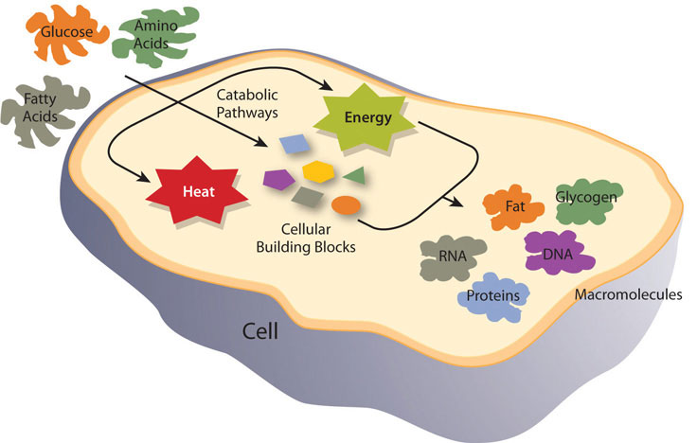
ATP

Slide 5
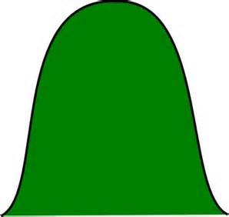
Catabolic pathway
Anabolic pathway
Metabolic landscape
Energy
released
Energy
used
Energy
stored

Slide 6

Different types of Energy
(energy=the ability to do work or cause change)
Potential
Kinetic
Energy stored in an object.
Measured in joules
Chemical energy is potential energy of a chemical reaction.
Energy of an object in motion.
Measured in joules
Thermal energy is kinetic energy of atoms or molecules
Potential energy
Kinetic energy

Slide 7
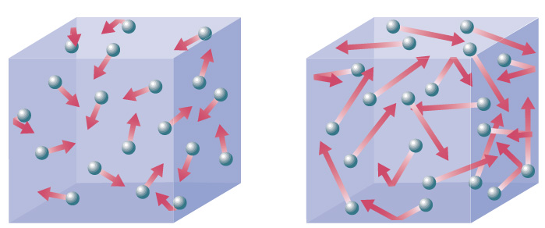
Thermal/Heat Energy
  Random movement of atoms or molecules

Slide 8
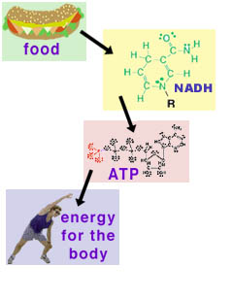
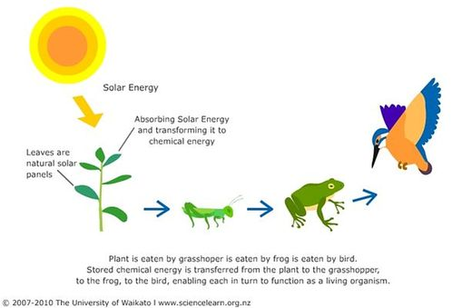
Chemical energy
  Potential energy available for release in a chemical reaction.

Slide 9
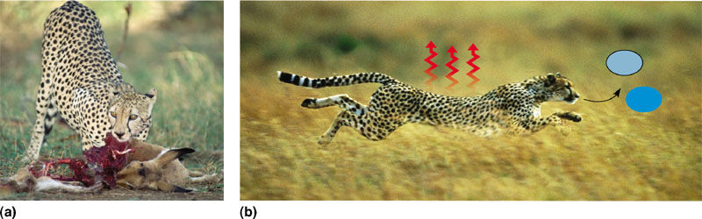
LAWS OF THERMODYNAMICS
Most energy is lost as heat
  Is the study of energy transformations
Heat
CO₂
H₂O
Chemical potential energy
TO
Kinetic energy
1st Law: Energy can be transferred and transformed but it can’t be created or destroyed.
2nd Law: Every energy transfer or transformation increases the entropy of the universe.

Slide 10
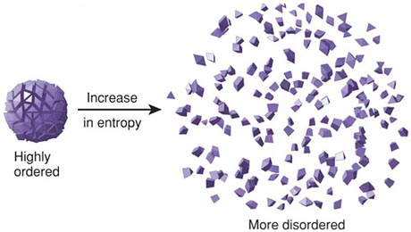
What is entropy?
Less energy needed to maintain
LIFE REQUIRES A LACK OF ENTROPY

Slide 11
FREE ENERGY
Is the energy in a system that is available to do work.

Slide 12
FREE ENERGY
ΔG = Δ H – T Δ S
What does this equation really mean?
The equation describes the change in free energy of a system when accounting for the transfer of heat (enthalpy) and change in disorder (entropy) of the system.
Entropy refers to the amount of disorder in a system. When placed in the context of energy exchange, entropy refers to energy that is unavailable for use.
What do we use free energy for????
To grow, reproduce & organize

Slide 13
Remember…
Less energy needed to maintain
LIFE REQUIRES A LACK OF ENTROPY

Slide 14
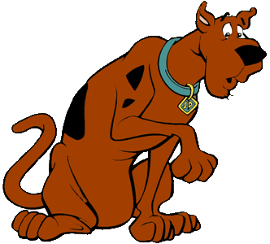
How is a lack of entropy achieved?
A constant supply of energy is needed.
Let’s look again at the 2nd law…
2nd Law: Every energy transfer or transformation increases the entropy of the universe.
So more energy = more randomness or disorder.
RUH-ROH!!
Increased disorder / entropy are offset by biological processes that maintain or increase order.

Slide 15
The energy in a system available for conversions is called : Gibbs Free Energy
The change in free energy that occurs as a result of a conversion is represented by ΔG.
Not all of this energy is actually available for chemical reactions because during the reaction some energy will be transferred as heat.
  As entropy increases
The ΔG can be positive or negative.

Slide 16
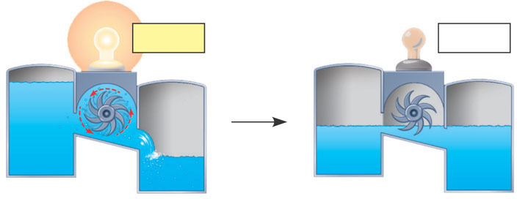
Equilibrium and Metabolism
Reactions in a closed system (unable to exchange matter or energy with its environment)
  Eventually reach equilibrium
∆G < 0
∆G = 0
(a) A closed hydroelectric system. Water flowing downhill turns a turbine
that drives a generator providing electricity to a light bulb, but only until
the system reaches equilibrium.
Figure 8.7 A

Slide 17
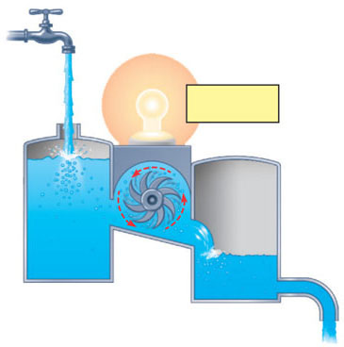
Cells in our body (open system)
  Experience a constant flow of materials in and out, preventing metabolic pathways from reaching equilibrium
      If our cells reach equilibrium , they are dead
(b) An open hydroelectric
system. Flowing water
keeps driving the generator
because intake and outflow
of water keep the system
from reaching equlibrium.
∆G < 0
Figure 8.7

Slide 18
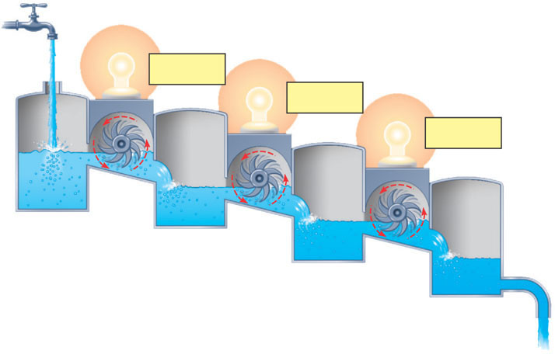
An analogy for cellular respiration
∆G < 0
∆G < 0
∆G < 0
Figure 8.7
(c) A multistep open hydroelectric system. Cellular respiration is
analogous to this system: Glucose is broken down in a series
of exergonic reactions that power the work of the cell. The product
of each reaction becomes the reactant for the next, so no reaction
reaches equilibrium.

Slide 19
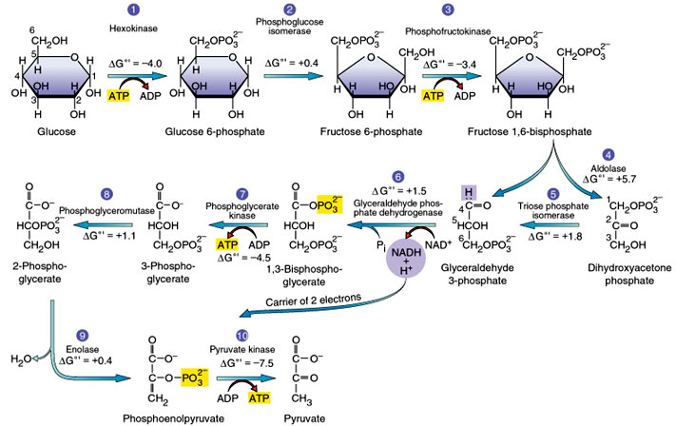
Different sugars can enter different places in the glycolysis
NO, YOU DON’T HAVE TO MEMORIZE THIS ☺

Slide 20
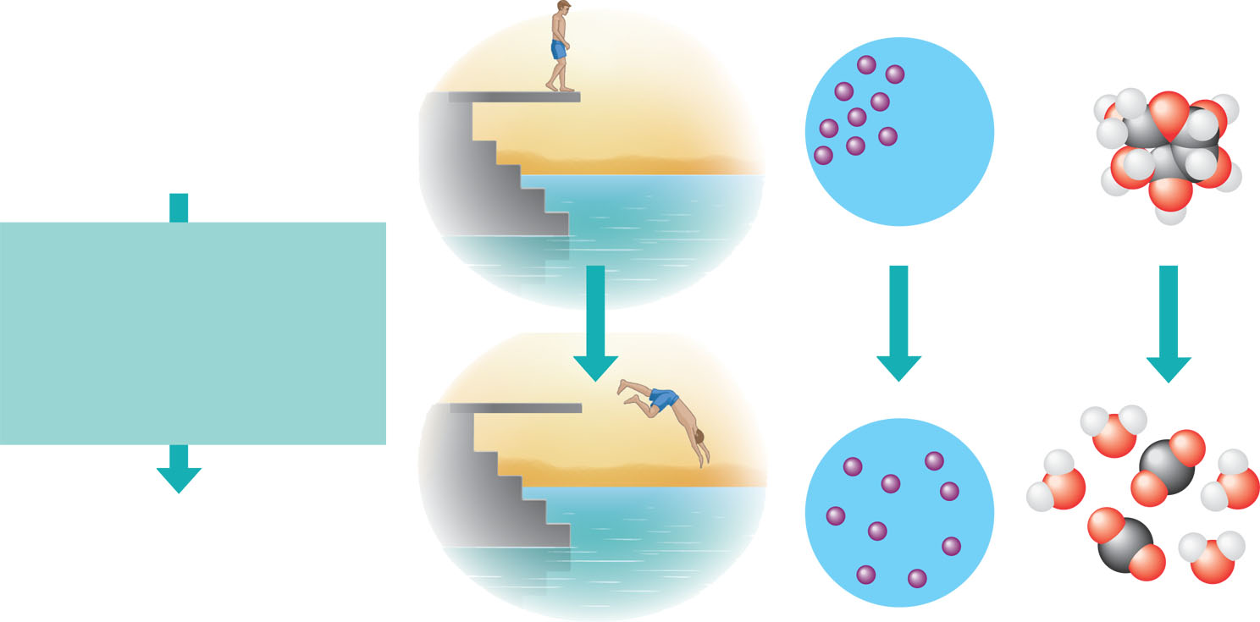
Unstable systems (top) are rich in free energy. They have a tendency to change spontaneously to a more stable state (bottom).
More free energy (higher G)
Less stable
Greater work capacity
In a spontaneously change
The free energy of the system
decreases (∆G<0)
The system becomes more stable
The released free energy can
be harnessed to do work
.
Less free energy (lower G)
More stable
Less work capacity
(a)
Gravitational motion. Objects
move spontaneously from a
higher altitude to a lower one.
(b)
(c)
Diffusion. Molecules
in a drop of dye diffuse
until they are randomly dispersed.
Chemical reaction. In a
cell, a sugar molecule is
broken down into simpler
molecules.
Figure 8.5

Slide 21
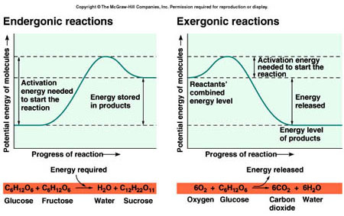
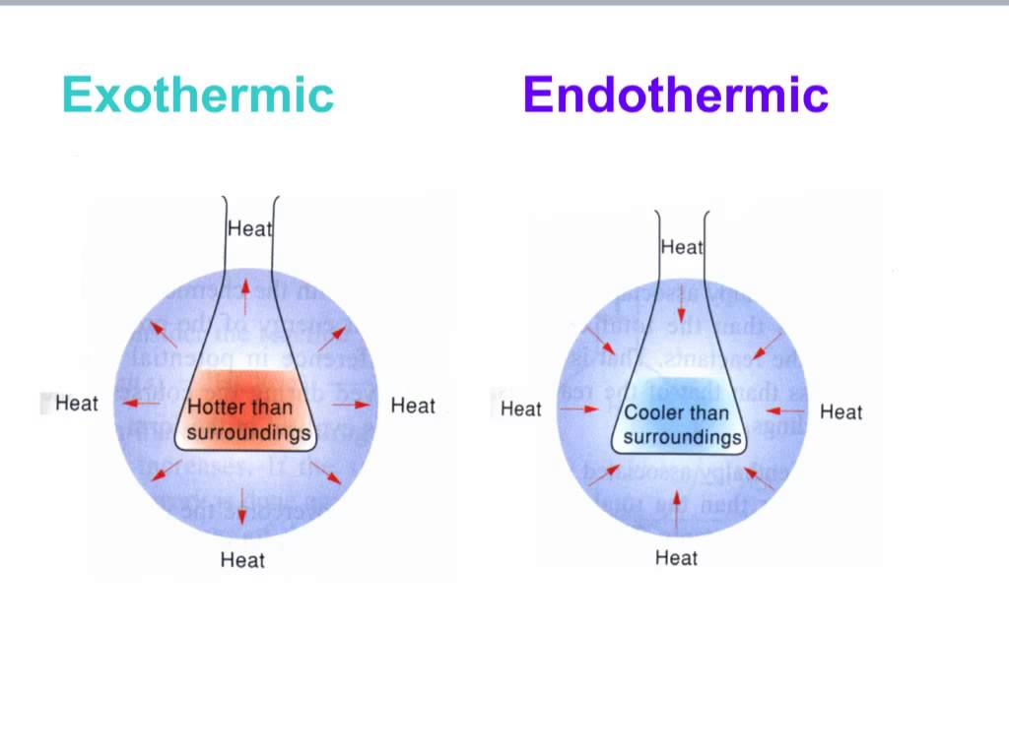
Exergonic and Endergonic Reactions in Metabolism
An exergonic (energy outward) reaction
  Proceeds with a net release of free energy and is spontaneous (without input of energy)
    Cellular Respiration (food is oxidized in mitochondria of cells & then releases the energy stored in the chemical bonds)
G is negative

Slide 22
An endergonic (energy inward) reaction
  Is one that absorbs free energy from its surroundings and is nonspontaneous
    Stores/consumes free energy
      EX: photosynthesis: when plants use carbon dioxide & water to form sugars
G is positive
Notice that the products have more energy than the reactants
The products gained energy in the form of heat

Slide 23
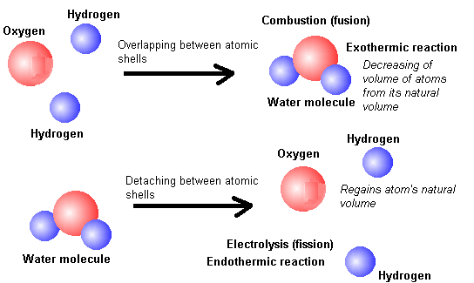

Slide 24
Energy coupling
Most cellular reactions are endergonic and can not occur spontaneously.
  So they require energy

Slide 25
The principal molecule involved in providing the energy for endergonic cellular reactions to take place is adenosine triphosphate.
The hydrolysis of
ATP
forming ADP
This would occur in tandem or coupled with the endergonic metabolic reaction

Slide 26
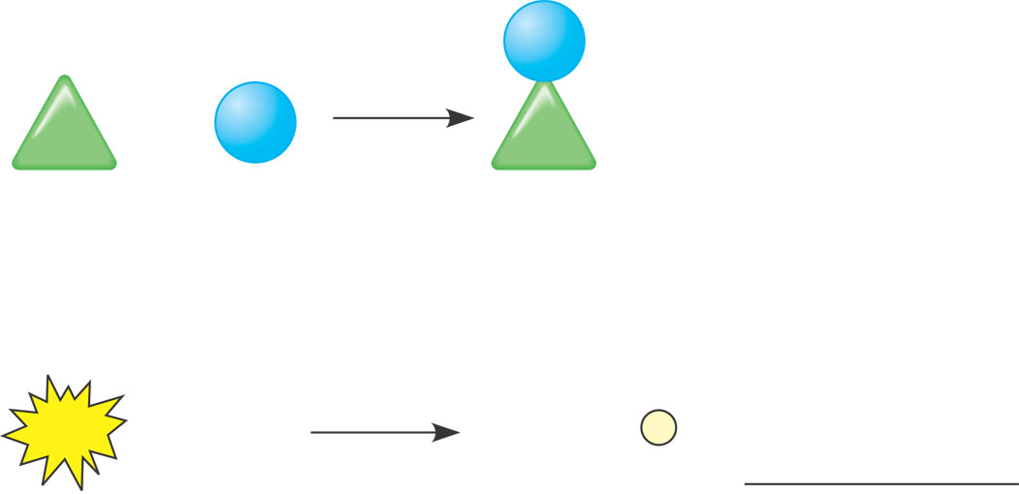
An Example of Coupling ATP and endergonic reactions
Endergonic reaction: ∆G is positive, reaction
is not spontaneous
NH₂
+
NH₃
∆G = +3.4 kcal/mol
Glu
Glu
Glutamic
acid
Ammonia
Glutamine
Exergonic reaction: ∆ G is negative, reaction
is spontaneous
ATP
+
H₂O
ADP
+
P
∆G = - 7.3 kcal/mol
Figure 8.10
Coupled reactions: Overall ∆G is negative;
together, reactions are spontaneous
∆G = –3.9 kcal/mol

Slide 27
Another example, consider a common endergonic reaction in plants in which glucose and fructose are joined together to make sucrose. To enable this reaction to take place, it is coupled with a series of other exergonic reactions as follows:
glucose + adenosine triphosphate (ATP) → glucose-p + ADP
fructose + ATP → fructose-p + adenosine diphosphate (ADP)
glucose-p + fructose-p → sucrose + 2 Pi(inorganic phosphate)
Therefore, although producing sucrose from glucose and fructose is an endergonic reaction, all three of the foregoing reactions are exergonic. This is representative of the way cells facilitate endergonic reactions.

Slide 28
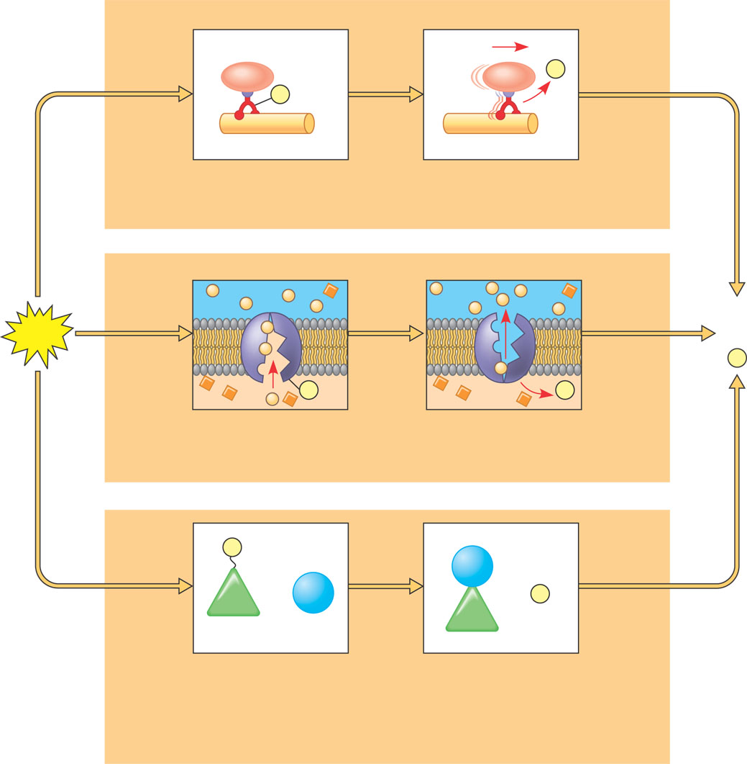
How ATP Performs Work
ATP drives endergonic reactions
  By phosphorylation, transferring a phosphate to other molecules
The 3 types of cellular work
  Are powered by the
  hydrolysis of ATP
P _{i}
P
Motor protein
Protein moved
(a) Mechanical work: ATP phosphorylates motor proteins
  Mechanical
  Transport
  Chemical
Membrane
protein
ADP
ATP
+
P _{i}
P
P _{i}
Solute
Solute
transported
(b) Transport work: ATP phosphorylates transport proteins
P
NH₂
+
NH₃
+
P _{i}
Glu
Glu
Reactants: Glutamic acid
and ammonia
Product (glutamine)
made
Figure 8.11
(c) Chemical work: ATP phosphorylates key reactants

Slide 29
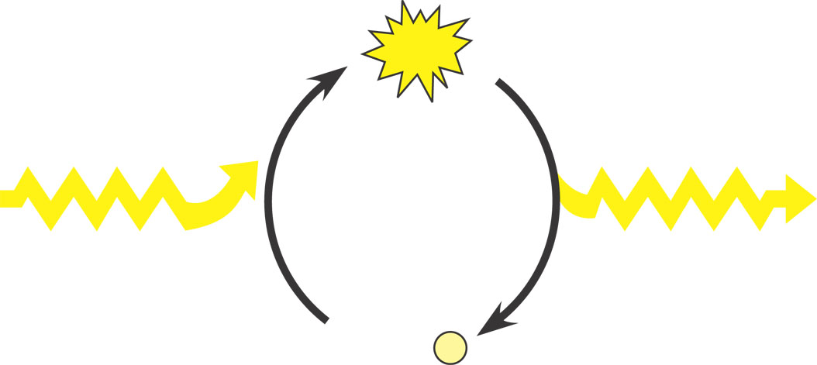
The Regeneration of ATP
Catabolic pathways
  Drive the regeneration of ATP from ADP and phosphate
ATP synthesis from
ADP + P _{i} requires energy
ATP hydrolysis to
ADP + P _{i} yields energy
Change in free energy is positive; nonspontaneous
Change in free energy is negative; spontaneous
ATP
Energy from catabolism
(exergonic, energy yielding
processes)
Energy for cellular work
(endergonic, energy-
consuming processes)
Figure 8.12
ADP + P _{i}

Slide 30
A major function of catabolism is to regenerate ATP.
If ATP production lags behind its use, ADP accumulates.
ADP then activates the enzymes that speed up catabolism, producing more ATP.
If the supply of ATP exceeds demand, then catabolism slows down as ATP molecules accumulate &bind these same enzymes inhibiting them.

Slide 31
Life Requires a highly ordered system
Order is maintained by constant free energy input into the system.
Loss of order or free energy flow results in death.
Increased disorder and entropy are offset by biological processes that maintain or increase order.

Slide 32
Organisms capture & store free energy for use in biological processes.

Slide 33
What do we use free energy for?
Organize, Grow, Reproduce, & maintain homeostasis

Slide 34
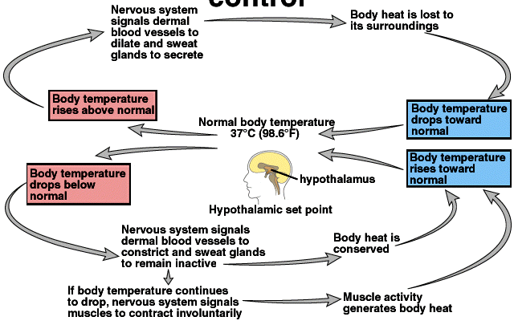
Endothermy -the use of thermal energy generated by metabolism to maintain homeostatic body temperature

Slide 35
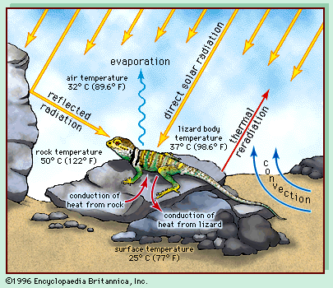
Ectothermy - the use of external thermal energy to help regulate & maintain body temperature.

Slide 36

Some flowers are able to elevate their temperatures for pollen protection & or pollinator attraction

Slide 37
Reproduction & rearing of offspring require free energy beyond that used for maintenance & growth.
Different organisms use various reproductive strategies in response to energy availability
Seasonal reproduction in animal and plants
Life-history strategy (biennial plants, reproductive diapause-delay in development)

Slide 38
What happens if there is a disruption in the amount of free energy?

Slide 39
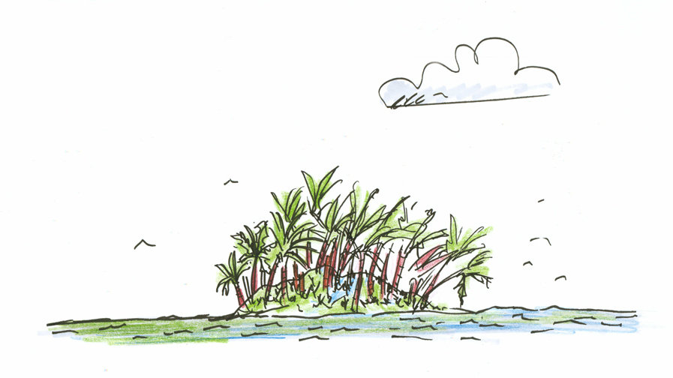
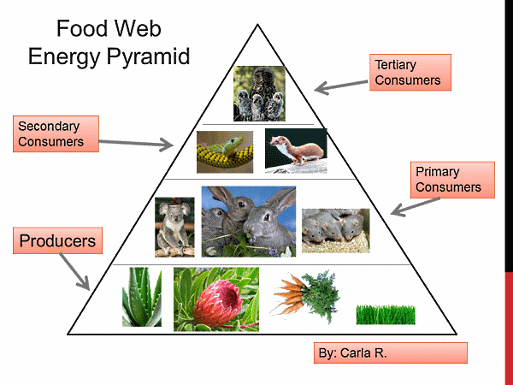
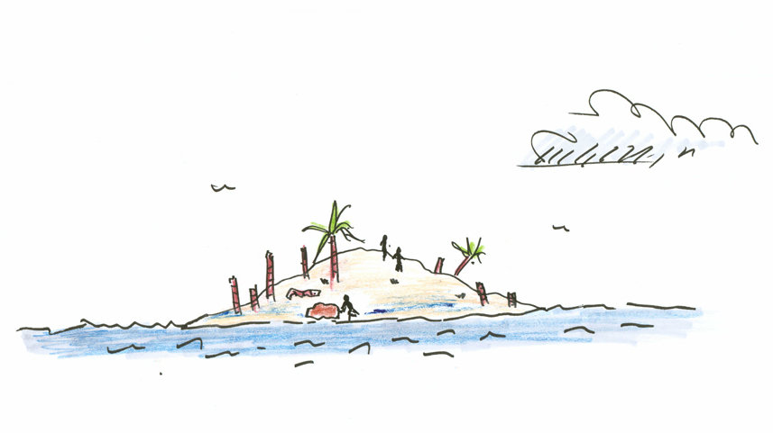
The simple answer is… you die
Let’s say sunlight is reduced.
What is going to happen?
Before
EX: Easter Island
-too populated & they cut down everything
After

Slide 40

ENZYMES

Slide 41
ALL METABOLIC REACTIONS IN ORGANISMS ARE CATALYSED BY ENZYMES.
SUBSTRATE A
SUBSTRATE B
FINAL PRODUCT
EACH ARROW REPRESENTS A SPECIFIC ENZYME THAT CAUSES ONE SUBSTRATE TO BE CHANGED INTO ANOTHER UNTIL THE FINAL PRODUCT OF THE PATHWAY IS FORMED
SOME PATHWAYS ARE CHAINS & OTHERS ARE CYCLES AND STILL OTHERS ARE CHAINS AND CYCLES.

Slide 42
Metabolic reactions in organisms
Must occur at body temperature
Body temperature does not get substrates to their transition state.
The active site of enzymes lowers the amount of energy needed to reach a transition state.

Slide 43
Function of Enzymes
A substrate has to reach an unstable, high-energy “transition state” where the chemical bonds are disestablished; this requires input of energy (activation energy).
When substrate reaches this transition stage it can immediately form the product.
Enzymes lower the activation energy of the substrate(s).

Slide 44
What is activation energy?
In chemistry activation energy is a term defined as the energy that must be overcome in order for a chemical reaction to occur.
The minimum energy required to start a chemical reaction.
The activation energy of a reaction is usually denoted by Ea and given in units of kilojoules per mole.

Slide 45
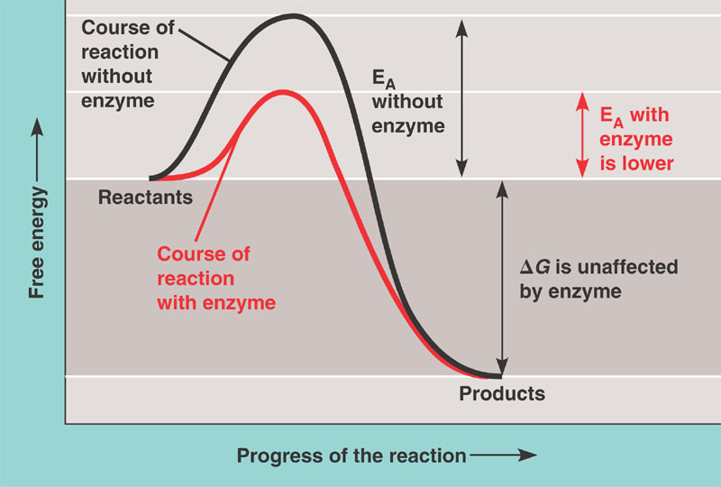

Slide 46
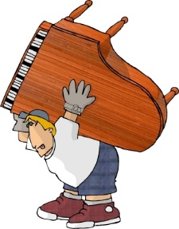
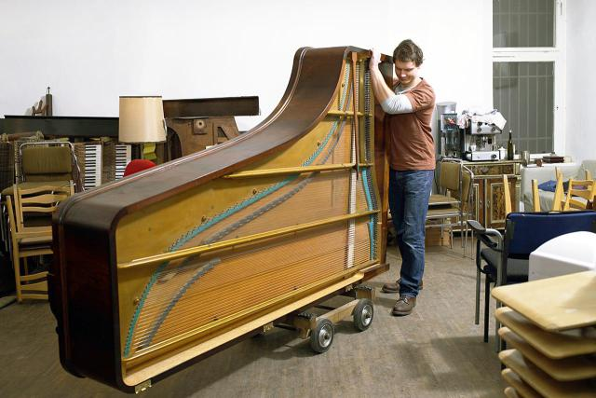
WITHOUT ENZYMES
WITH ENZYMES
How does the activation energy necessary to move the piano differ in each of these scenarios?
Does the end result differ depending on the situation?

Slide 47
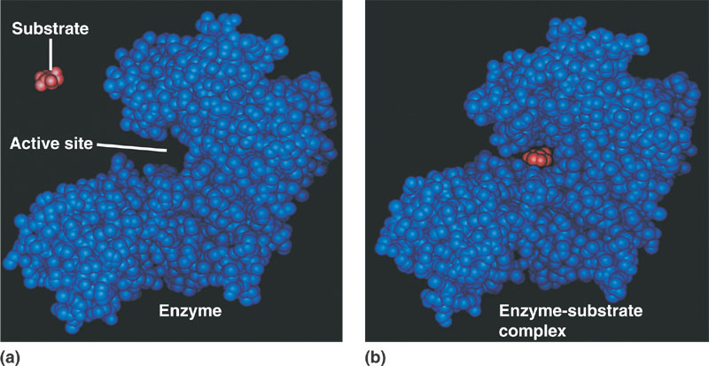
Induced-fit Model of Enzyme Action
As the enzyme changes shape the substrate is activated so it can react & the resulting product or products is released.
Enzyme then returns to its original shape

Slide 48
Sometimes enzymes need to be turned off.
For example, a complicated system of enzymes and cells in your blood has the task of forming a clot whenever you are cut, to prevent death from blood loss.
If these cells and enzymes were active all the time, your blood would clot with no provocation and it would be unable to deliver oxygen and nutrients to the peripheral tissues in your body.

Slide 49
Playing with enzymes
Pick up a baggie.
The blue “C” shape one is the enzyme.
Try to figure out how enzymes, substrates, competitive & non-competitive inhibitors work.

Slide 50
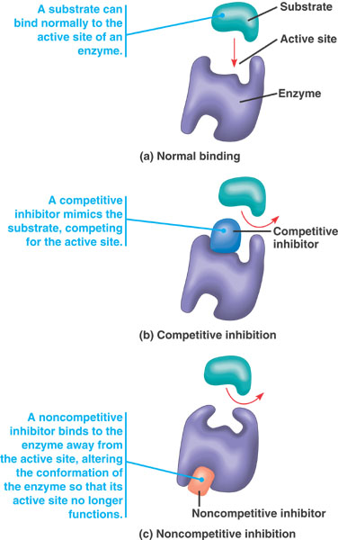
NORMAL
COMPETITIVE INHIBITION
Many medical drugs are inhibitors
NON-COMPETITIVE INHIBITION
Many toxins are non-competitive inhibitors such as mercury & lead

Slide 51
Methanol (CH₃OH) is a poison(anti-freeze, paint thinner), not because of what it does to the body itself, but because the enzyme alcohol dehydrogenase oxidizes it to formaldehyde, CH₂O, which is a potent poison. A treatment of methanol poisoning is to give the patient ethanol, CH₃CH₂OH. Why is this effective?
Ethanol is a competitive inhibitor of methanol to alcohol dehydrogenase. It competes with methanol for the active site. Thus, as ethanol is added, less methanol can bind to alcohol dehydrogenase's active sites. Formaldehyde is produced at a slower rate, so the patient doesn't get as sick.
Like methanol, ethanol is metabolized by ADH, but the enzyme’s affinity for ethanol is 10-20 times higher than it is for methanol.

Slide 52
What are other factors that may affect enzymes activity
pH optimal for most enzymes= 6-8
  Pepsin (in stomach) likes a pH of 2
Temperature- humans (35-40⁰C)
  Thermal agitation = bonds breaking →denaturing
Cofactors- non proteins (if organic = coenzyme)
  Make up part of the active site.
  Most vitamins are coenzymes.
    Members of the vitamin B complex = metabolizes carbohydrates, proteins, and fats.

Slide 53
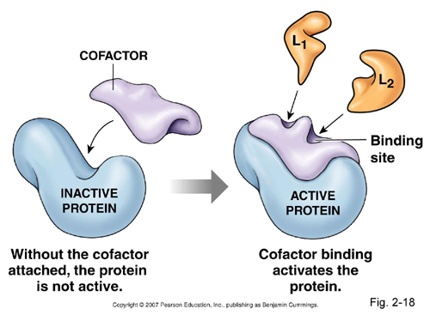
Coenzyme
or

Slide 54
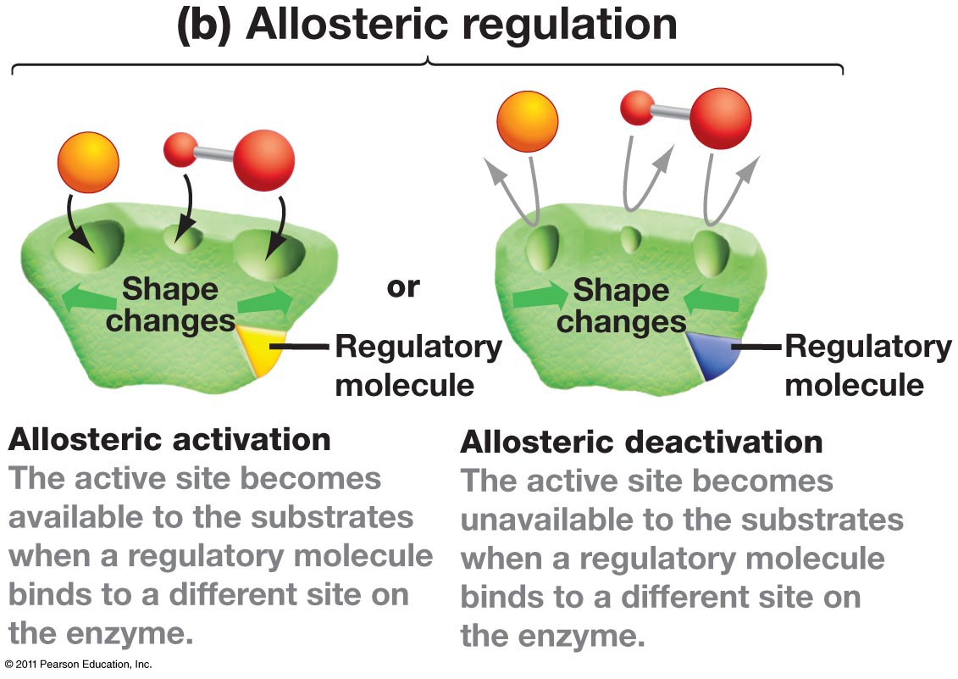
Regulation of Enzyme Activity

Slide 55
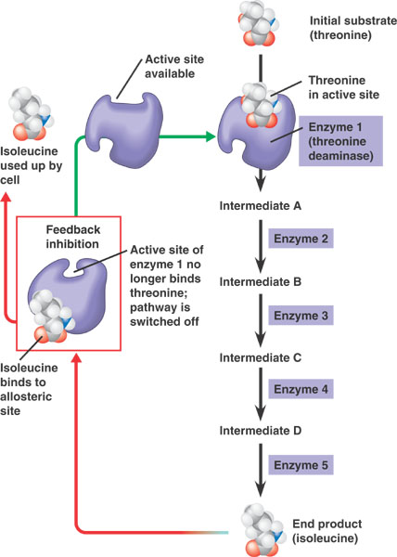
Feedback Inhibition

Slide 56
Specific Localization of Enzymes Within the Cell
The cell is compartmentalized and cellular
structures play a part in bringing order to the
metabolic pathways.
Sometimes, like in cellular respiration, there are
a group of enzymes in a multi step pathway
located in different locations of one organelle
(such as the mitochondria)

Slide 57
LET’S DO AN INTERACTIVE COMPUTER ACTIVITY ABOUT THERMODYNAMICS- CONNECTING CONCEPTS IN BIOLOGY

Slide 58


Slide 59
BIG IDEA 2
Biological systems utilize free energy and molecular building blocks to grow, to reproduce & to maintain dynamic homeostasis

Slide 60
Growth, reproduction and maintenance of the organization of living systems require free energy and matter

Slide 61
All living systems require constant input of free energy
Life requires a highly ordered system.
Evidence of your learning is a demonstrated understanding of each of the following:
  1. Order is maintained by constant free energy input into the system.
  2. Loss of order or free energy flow results in death.
  3. Increased disorder and entropy are offset by
  biological processes that maintain or increase
  order.

Slide 62
All living systems require constant input of free energy
Living systems do not violate the second law of thermodynamics, which states that entropy increases over time.
Evidence of your learning is a demonstrated understanding of each of the following:
  1. Order is maintained by coupling cellular processes that increase entropy (and so have negative changes in free energy) with those that decrease entropy (and so have positive changes in free energy).
  2. Energy input must exceed free energy lost to entropy to maintain order and power cellular processes.
  3. Energetically favorable exergonic reactions, such as ATP→ADP, that have a negative change in free energy can be used to maintain or increase order in a system by being coupled with reactions that have a positive free energy change.

Slide 63
All living systems require constant input of free energy
Energy-related pathways in biological systems are sequential and may be entered at multiple points in the pathway.
To foster student understanding of this concept, instructors can choose an illustrative example such as:
  • Krebs cycle
  • Glycolysis
  • Calvin cycle
  • Fermentation

Slide 64
All living systems require constant input of free energy
Organisms use free energy to maintain organization, grow and reproduce.
Evidence of your learning is a demonstrated understanding of each of the following:
  1. Organisms use various strategies to regulate body temperature and metabolism.
To foster your understanding of this concept, you can choose an illustrative example such as:
    • Endothermy (the use of thermal energy generated by metabolism to maintain homeostatic body temperatures)
    • Ectothermy (the use of external thermal energy to help regulate and maintain body temperature)
    • Elevated floral temperatures in some plant species

Slide 65
All living systems require constant input of free energy
Reproduction and rearing of offspring require free energy beyond that used for maintenance and growth. Different organisms use various reproductive strategies in response to energy availability.
To foster your understanding of this concept, you can choose an illustrative example such as:
    • Seasonal reproduction in animals and plants
    • Life-history strategy (biennial plants, reproductive diapause)
There is a relationship between metabolic rate per unit body mass and the size of multicellular organisms — generally, the smaller the organism, the higher the metabolic rate.
Excess acquired free energy versus required free energy expenditure results in energy storage or growth.
Insufficient acquired free energy versus required free energy expenditure results in loss of mass and, ultimately, the death of an organism.

Slide 66
All living systems require constant input of free energy
Changes in free energy availability can result in changes in population size.
Changes in free energy availability can result in disruptions to an ecosystem.
To foster your understanding of this concept, you can choose an illustrative example such as:
  • Change in the producer level can affect the number and size of other trophic levels.
  • Change in energy resources levels such as sunlight can affect the number & size of the trophic levels.

